Slide 1
Automatic DFKG
Under Guidance of
Frank xu
By Jeel Piyushkumar Khatiwala
Notes:
https://www.cfreds.nist.gov/data_leakage_case/data-leakage-case.html

Slide 2
Introduction
An exciting project aimed at developing an Automatic Digital Forensics Knowledge Graph (DFKG). This project is designed to create an advanced tool for digital forensic investigations by constructing a detailed knowledge graph that facilitates efficient analysis and correlation of digital evidence. The first phase of this project focuses on extracting database files from specific folders within Android phone images.

Slide 3
Description
In the initial phase of the Automatic Digital Forensics Knowledge Graph (DFKG) project, we will undertake the following tasks:
Extract Database Files:
Identify and extract all relevant database files from designated folders within the Android phone image.
Organize Files:
Gather all extracted database files and place them in a separate, centralized folder for easy access.
Convert each tables from DB files to CSV File:
Record essential details about each files and save them based on the tables.
Fetch the Evidence from CSV files:
Getting Name, Email, Phone number, Address etc. from CSV files.

Slide 4
Problem Statement
In digital forensic investigations, extracting, organizing, and analyzing data from mobile devices presents significant challenges. The manual process of retrieving relevant database files from Android phone images is time-consuming and error-prone. Ensuring the integrity and traceability of these files throughout the investigation is also difficult to manage.
To address these issues, there is a need for an automated system that can efficiently extract database files from specific folders within Android phone images, organize them centrally, and document essential details such as file name, original location, and hex values. This system will enhance the efficiency, accuracy, and reliability of digital forensic investigations.
Notes:
https://cellebrite.com/en/part-1-ctf-2022-write-up-marshas-pc/
Case Resource can be found here: https://cellebrite.com/en/part-1-ctf-2022-write-up-marshas-pc/

Slide 5
Case scenario
Beth Dutton was arrested
Time: 5:00 PM on July 21st
Location: Vienna Inn in Vienna, VA
Charge: stealing and selling cars with a cash transfer
Beth claimed that
Marsha Mellos, her sister, introduced her to Heisenberg
Heisenberg invited her to Vienna
Heisenberg was responsible for stealing cars.
She and her sister were innocent.
She and her sister are in the cattle business in Montana.
Devices involved in the scenario
Marsha: a PC and an iPhone.
Beth: an iPhone
Heisenberg: an Android.
Notes:
https://cellebrite.com/en/part-1-ctf-2022-write-up-marshas-pc/
Case Resource can be found here: https://cellebrite.com/en/part-1-ctf-2022-write-up-marshas-pc/

Slide 6
2. Install software
Optional: If you downloaded Kali, you can skip this section

Slide 7
3. Get the data folder from Heisenberg's Android File
Data folder from Heisenberg's Android https://drive.google.com/file/d/1WzRH_32jfHQfipLbr2jv-ts7X5umQk2n/view?usp=sharing
Notes:
Folder Downlaod URL: https://drive.google.com/file/d/1WzRH_32jfHQfipLbr2jv-ts7X5umQk2n/view?usp=sharing

Slide 8
How to download the file
Download Data Folder
Images are hosted on a Google Drive. Use this link: https://drive.google.com/file/d/1WzRH_32jfHQfipLbr2jv-ts7X5umQk2n/view?usp=sharing
Notes:
https://drive.google.com/file/d/1WzRH_32jfHQfipLbr2jv-ts7X5umQk2n/view?usp=sharing

Slide 9
MD5 and SHA-256 Checksums of Downloaded Zip File to verify integrity
Notes:
﻿﻿md5sum data.zip && sha256sum data.zip

Slide 10
Locate the Zip file

Slide 11
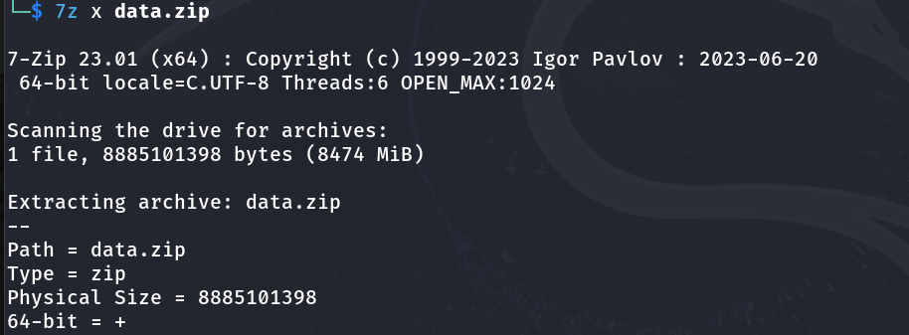
Unzip file using 7z
Notes:
sudo apt-get update
sudo apt-get install p7zip 7z x -p02DB2ECE91DB67E8FA939FC3DC15D16B CTF21_Heisenberg_SM-N970U1_QualcommLive_2021-07-22.zip Verify File integrity to check if corrupted: 7z t CTF21_Heisenberg_SM-N970U1_QualcommLive_2021-07-22.zip

Slide 12
Code Approach Methodology
Database files
(Rename them with the respective hex values to avoid duplication)
Android Image
Fetching the evidences (Name, Phone Number, Address, Email Address)
CSV Files
(Converted)
Notes:
Python location_fetch_files.py

Slide 13
4. Use python code to extract the database files.
Automatic DFKG/step1/file_fetch(report).py
Python script on GitHub: https://github.com/jeelkhatiwala/Automatic---DFKG-main-

Slide 14
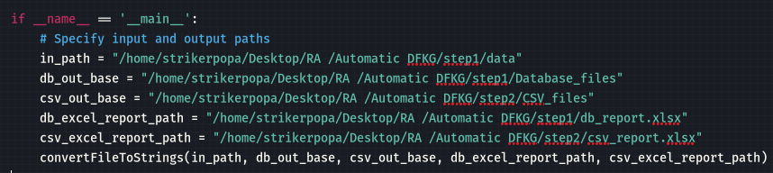
Location of Input folder
Change the file paths as per you file location for both Input and output files
Location of output folder
Location of output excel report location
Location of output CSV folder
Location of output excel report location
Notes:
Replace the path with your file paths

Slide 15
Command to run python script
Run the python script provided on GitHub.
Notes:
Go tp the location of the python file and run the script. Python location_fetch_files.py

Slide 16
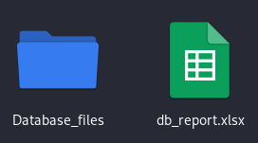
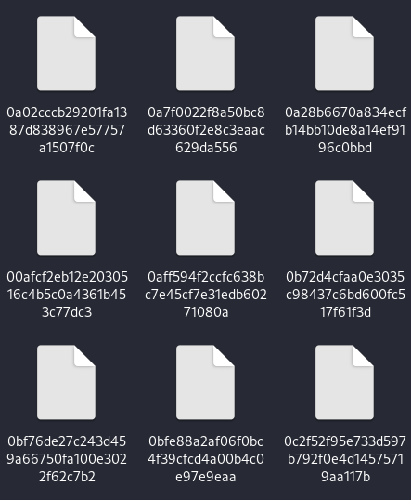
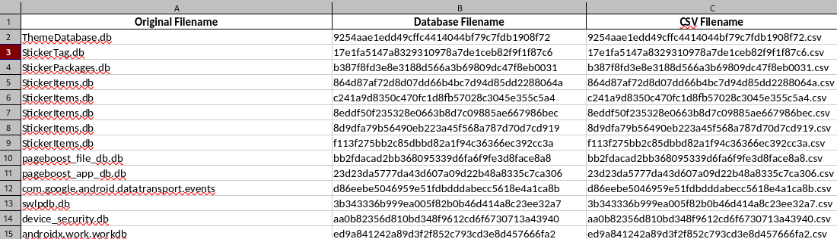
Output files in Database folder (Step 1)
Notes:
Access db. Files: https://drive.google.com/drive/folders/1qdzXLemvztM8MIwqDcFF4PJban_dj4Cc?usp=sharing

Slide 17
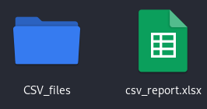
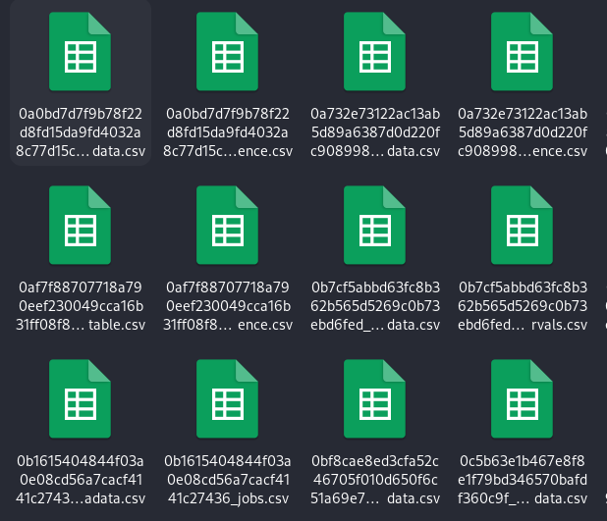
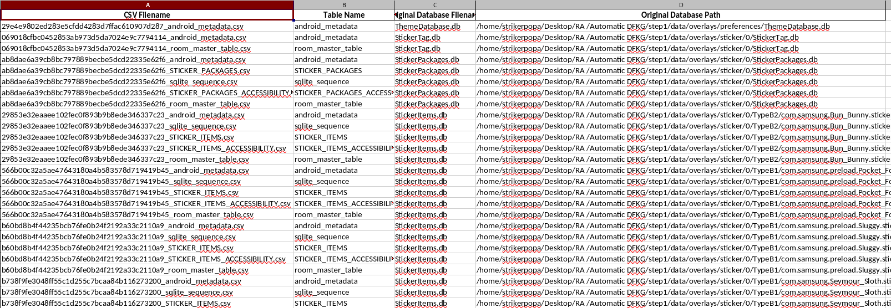
Output files CSV folder (Step 2)
Notes:
Access db. Files: https://drive.google.com/drive/folders/1qdzXLemvztM8MIwqDcFF4PJban_dj4Cc?usp=sharing

Slide 18
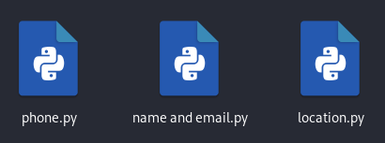
4. Fetching Information
Automatic DFKG/step3/location.py
Automatic DFKG/step3/name and email.py
Automatic DFKG/step3/phone.py
Python script on GitHub: https://github.com/jeelkhatiwala/Automatic---DFKG-main-
Notes:
Python script on GitHub: https://github.com/jeelkhatiwala/Automatic---DFKG-main-

Slide 19


Location.py
Location of Input files/folder
Change the file paths as per you file location for both Input and output files
Location of output excel file
Run the python script provided on GitHub.
Command to run python script
Notes:
Python script on GitHub: https://github.com/jeelkhatiwala/Automatic---DFKG-main-

Slide 20
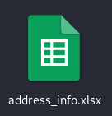
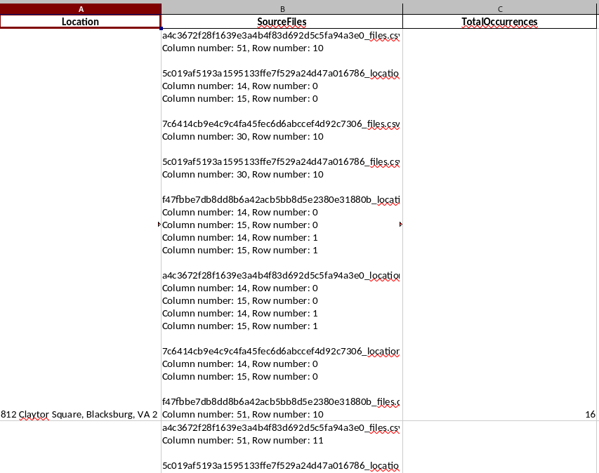
Output file of location.py
Notes:
Python script on GitHub: https://github.com/jeelkhatiwala/Automatic---DFKG-main-

Slide 21

Phone.py
Location of Input files/folder
Change the file paths as per you file location for both Input and output files
Location of output excel file
Run the python script provided on GitHub.
Command to run python script
Notes:
Python script on GitHub: https://github.com/jeelkhatiwala/Automatic---DFKG-main-

Slide 22
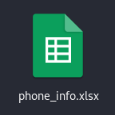
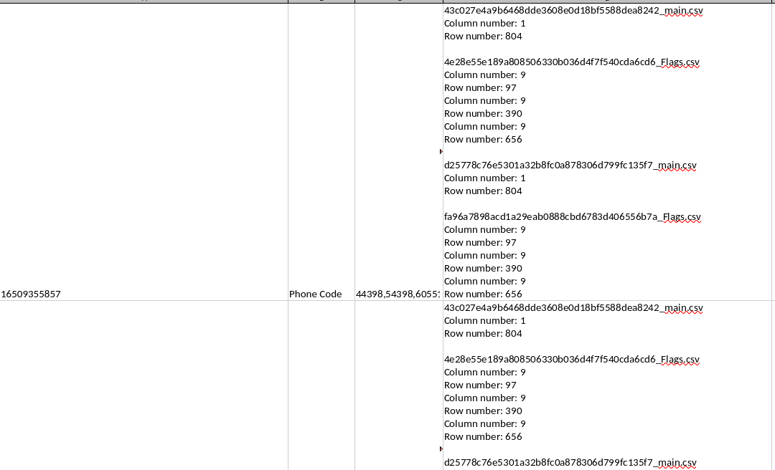
Output file of phone.py
Notes:
Python script on GitHub: https://github.com/jeelkhatiwala/Automatic---DFKG-main-

Slide 23
Name and Email.py
Location of Input files/folder
Change the file paths as per you file location for both Input and output files
Location of output excel file
Run the python script provided on GitHub.
Command to run python script
Notes:
Python script on GitHub: https://github.com/jeelkhatiwala/Automatic---DFKG-main-

Slide 24
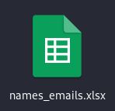
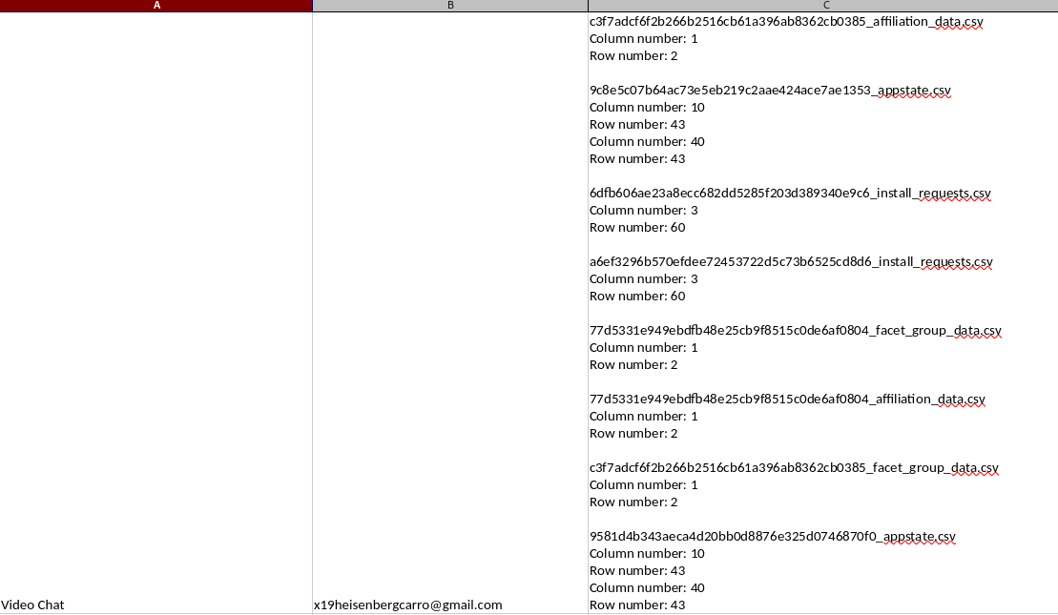
Output file of phone.py
Notes:
Python script on GitHub: https://github.com/jeelkhatiwala/Automatic---DFKG-main-

